Slide 1
Office of Institutional Effectiveness Step-by-Step Assessment Guide
Pepperdine University

Slide 2
Start with Learning Outcomes
Specific
Clear
Measurable
Appropriate Rigor
Appropriate domain
They should not be about what the program will do but about what the students will achieve
PLOs should be measurable and at the level of mastery in accordance with the level of the degree

Slide 3
Mapping
Why is this important?
Mapping demonstrates the relationship between learning and curriculum sequencing
Mapping demonstrates the alignment between the courses and the PLOs (and ILOs and Core Competencies)

Slide 5
5 year Assessment Plan completed at the start of the cycle
OIE will need completed, updated assessment plans from the last completed program review to the next scheduled program review.
Assessment Plan: This 5-year plan demonstrates what year you will assess each PLO, and what direct and indirect assessment work you will use to measure the PLO.

Slide 7
***Completed Assessment Plan***
Year One
PLO
Direct Assessment
Rubric – with criteria. This allows you to benchmark and set standards of performance. Plan ahead by having a rubric already developed for each of your PLOs.
Indirect Assessment – provides information for analysis and opportunities to involve students.

Slide 8
BENCHMARK RUBRIC TEMPLATE
Level of Accomplishment | EXPERT (Graduate or Professional Level Work) | Outstanding (Above Average) | Meets Expectation (Average Performance Level) | Below Expectation | Information not Present
 | Rarely, but occasionally, seen in an undergraduate student | Met the expectation but also extremely well done | 50-70% of Students should Score Here | Promising, but not quite there | This could be due to the responder or poor fit of the assignment
Dimension 1 | (Dimension Description) | (Dimension Description) | (Dimension Description) | (Dimension Description) | (Dimension Description)
Dimension 2 | (Dimension Description) | (Dimension Description) | (Dimension Description) | (Dimension Description) | (Dimension Description)
Dimension 3 | (Dimension Description) | (Dimension Description) | (Dimension Description) | (Dimension Description) | (Dimension Description)
Dimension 4 | (Dimension Description) | (Dimension Description) | (Dimension Description) | (Dimension Description) | (Dimension Description)

Slide 9
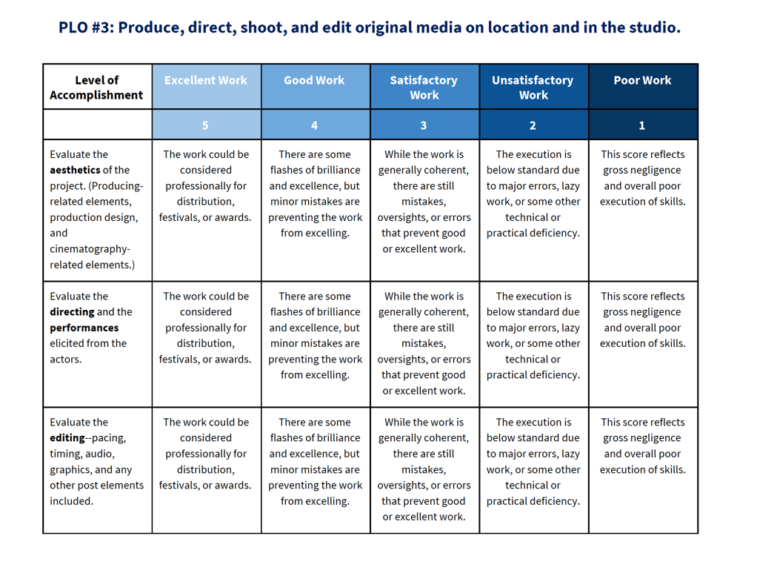
PLO #3: Produce, direct, shoot, and edit original media on location and in the studio.

Slide 11
5-Year Plan for Multimodal Assessment other things to consider…
A good methodology gives you good results!
Try to choose an assignment that demonstrates the students' best performance – an assignment that shows students' mastery of the PLO. Capstone assignments are a good place to start. They are usually at the point of mastery and often show mastery of more than one PLO.
Consider measuring a PLO more than once in an assessment cycle and using the same rubric so you can measure improvement and possibly set a benchmark for performance.
When developing rubrics, always have a score higher than what is expected for student achievement. If you use a 4 point rubric and expect students to earn both 3s and 4s make sure to add a 5, just in case!!

Slide 12
Collect Indirect Assessment
Indirect Assessment is most helpful when it is directly linked to Direct Assessment. For example, if you are measuring students' ability to solve a problem, you can use indirect assessment to ask them where they learned the skills and knowledge, how important they think it is to know this information, and what would have helped them learn it better. Indirect assessment is an opportunity to ask students about their learning, in order to get their insight into the student experience. This will help you explain the results of the Direct Assessment.
Common Types of Indirect Assessment:
Surveys: You can set up a short survey that students can fill out when they submit their assignment through LiveText. OIE can help you set this up.
Focus Group: You can conduct a focus group with a sample of your students. OIE can provide resources to help you conduct a focus group.
Reflective Essays: A separate “assignment” can be setup on LiveText to collect the reflective essays. With the correct prompt, reflective essays can give you insight into students’ learning processes.

Slide 13
Get the Ball Rolling!
Before You Begin
Create Normed Rubrics for Each PLO
-Build Rubrics (IN ADVANCE)
-Rubrics should have Criteria for Scoring
Before You Begin
Have an established tool for indirect assessment
Focus group
Survey
Reflective essay
Before You Begin
Assessment Plan, for 5 years, that identifies courses with direct and indirect assessment.
Before You Begin
Develop Program Learning Outcomes and Curricula Maps
Keep the Momentum Growing!
September → June
October → May
All data should be collected before students leave for the academic year
Score your rubric
Hold a focus group
Conduct a survey
MAY → JUNE
Write your annual assessment report.
September → October
Set up Indirect assessment
September → October
Assessment Software Set Up.
Establish Standards of Performance Using a Rubric

Slide 14
Submit your assessment materials to OIE at least one month prior to the collection of your assignment.
You will need to send OIE:
1. Course and Section number
2. Title of the Assignment
3. PLO being assessed
4. Rubric

Slide 15
Collect Student Assignments, then…
Score the students’ assignments in LiveText or Portfolium.
OIE can provide training, tutorial guides, and support if you need help. Once you learn how to navigate the assessment software, the process is pretty straight forward. The rubric and assignment are right there!

Slide 16
Use your data in your assessment report
View your data report on LiveText, &/or ask OIE to run a data report for you.
One of the main benefits of using LiveText or Portfolium for assessment is that it creates data tables for you from the scores in the rubrics. Also, you can see your initial report in the software right away.
If you would like more data than the initial report, put in a request with OIE, and they can pull a more detailed data report for you.

Slide 17
May 15
Write your Annual Assessment Report and Submit it by the due date: May 15.
This year we will use Google Sites to write and submit the reports.

Slide 18
Borrowed from James Madison University http://www.learningoutcomesassessment.org/documents/Occasional_Paper_23.pdf
Weigh the Pig
Feed the Pig
Weigh the Pig
Just like simply weighing a pig, doesn’t fatten it; just assessing student learning doesn’t improve student learning.
So, we must:
“weigh pig, feed pig, weigh pig” or
“assess, implement changes, re-assess.”

Slide 19
Thanks
We know not every program is the same, but following these guidelines as much as possible should help you develop a strong assessment methodology. Our hope is that preparing in advance will allow you to develop a thorough plan and streamline your assessment process.
The goal is for you to have meaningful data that can be used to finetune your curriculum.
And don’t forget, OIE is here to help! Don’t hesitate to reach out with any questions you may have.

