Slide 1
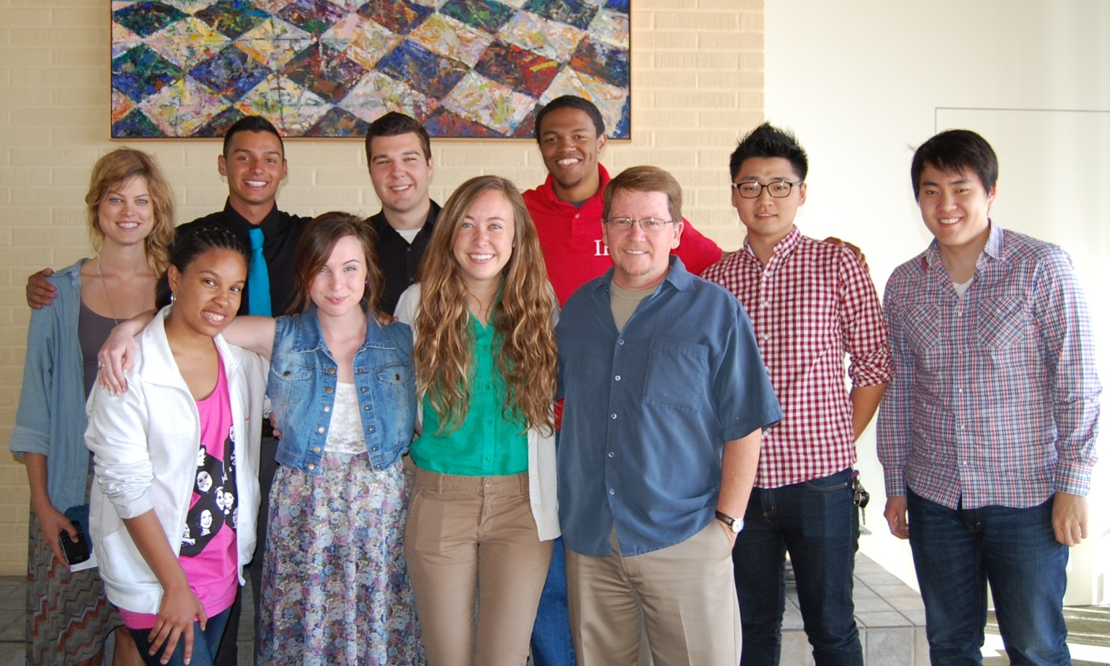
2013 Ministry Internship Grant Recipients
from the Center for Faith and Learning and the Religion Division

Slide 2
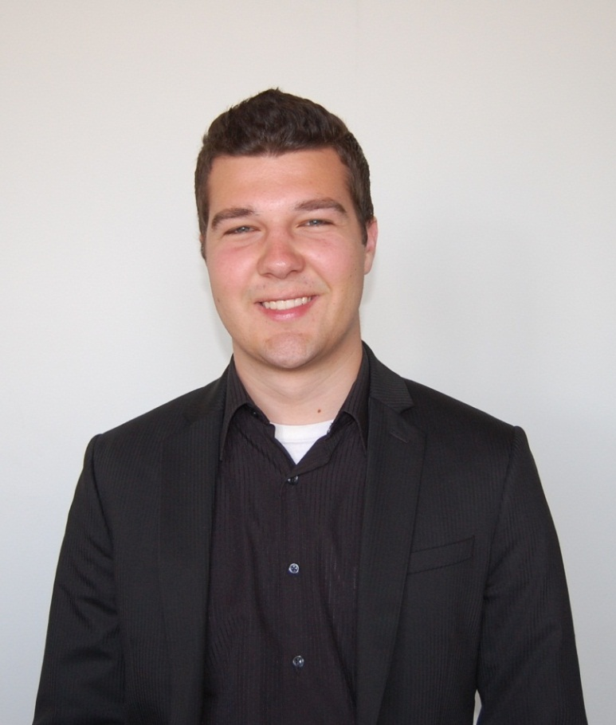
Alexander Fisher Recipient of Ministry Internship Grant from the Center for Faith and Learning and Religion Division
Alexander will be a youth ministry intern for the Westside Church of Christ in Bakersfield, California.

Slide 3
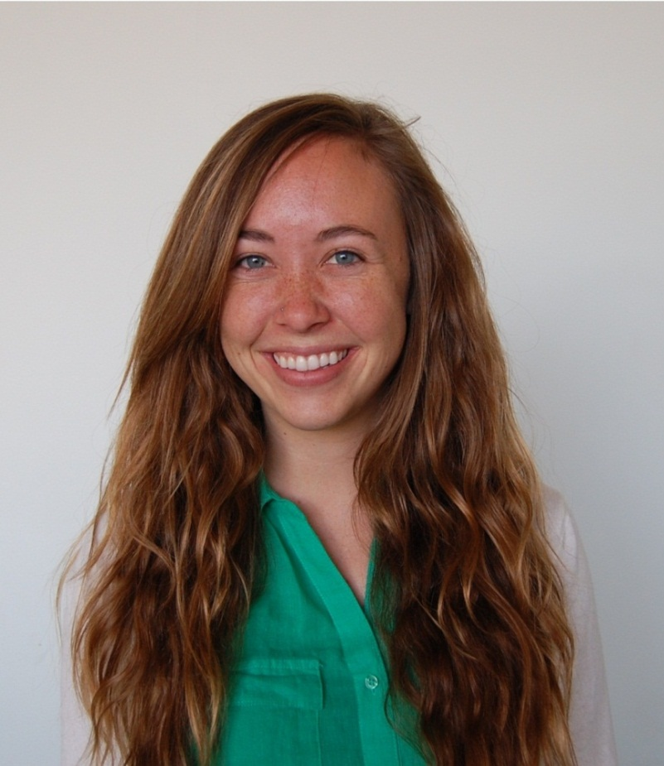
Callie Nibecker Recipient of Ministry Internship Grant from the Center for Faith and Learning and Religion Division
Callie will be a youth ministry intern for the University Church of Christ in Malibu, California.

Slide 4
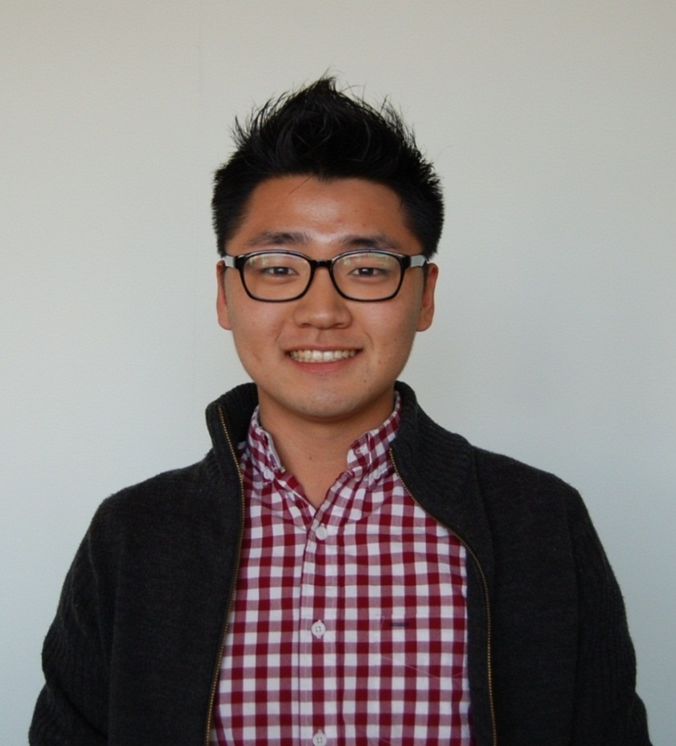
Calvin Yang Recipient of Ministry Internship Grant from the Center for Faith and Learning and Religion Division
Calvin will be working with Korean-speaking young adults and youth at Los Angeles Open Door Presbyterian Church in Korea Town.

Slide 5
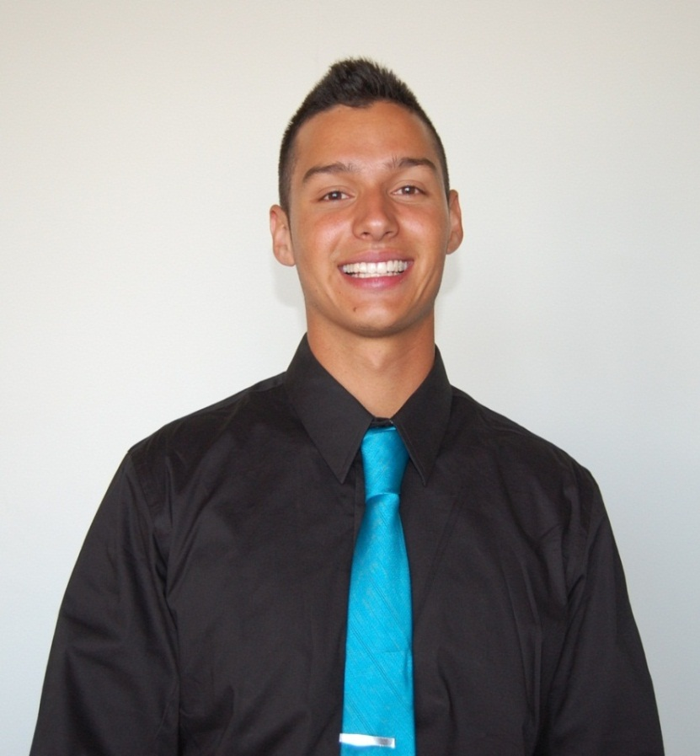
Daniel Mattox Recipient of Ministry Internship Grant from the Center for Faith and Learning and Religion Division
Daniel will be a youth intern for the University Church of Christ in Malibu, California and a young adult and youth intern for the Christ First Church of Covina.

Slide 6
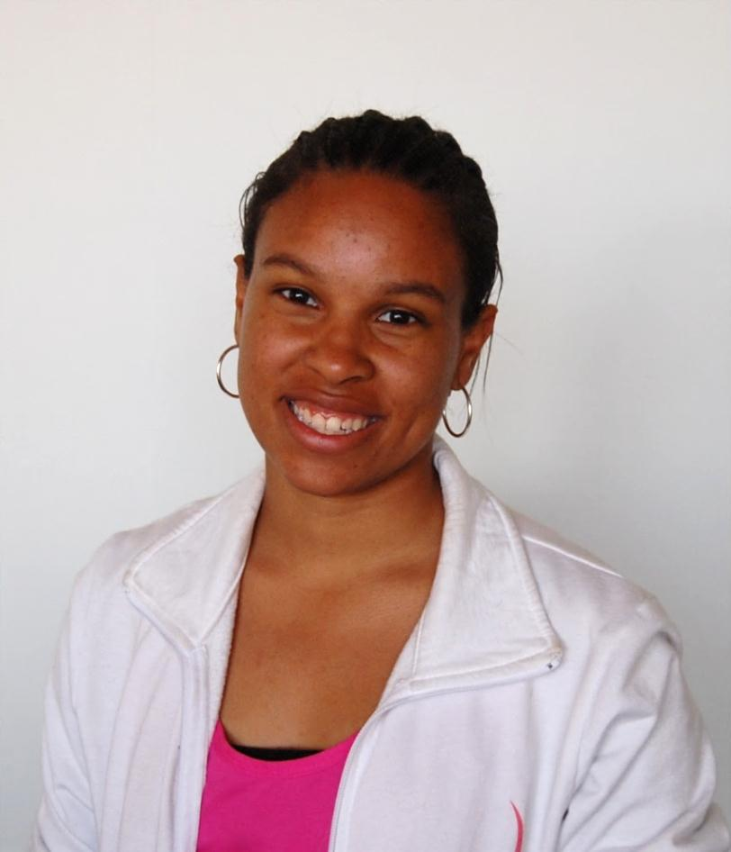
Demi McCoy Recipient of Ministry Internship Grant from the Center for Faith and Learning and Religion Division
Demi will be working with the White Rainbow Project, a ministry serving widows in India.

Slide 7
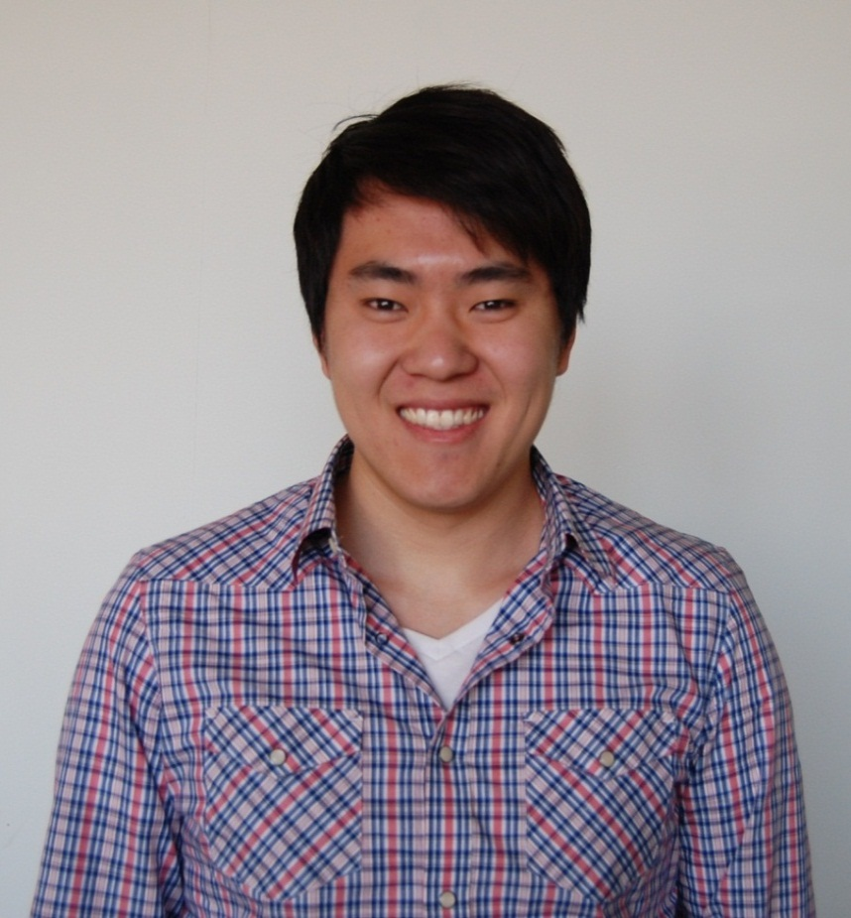
Eric Kim Recipient of Ministry Internship Grant from the Center for Faith and Learning and Religion Division
Eric will be working with New York Faith and Justice NPO and Trinity Grace Church in New York City.

Slide 8
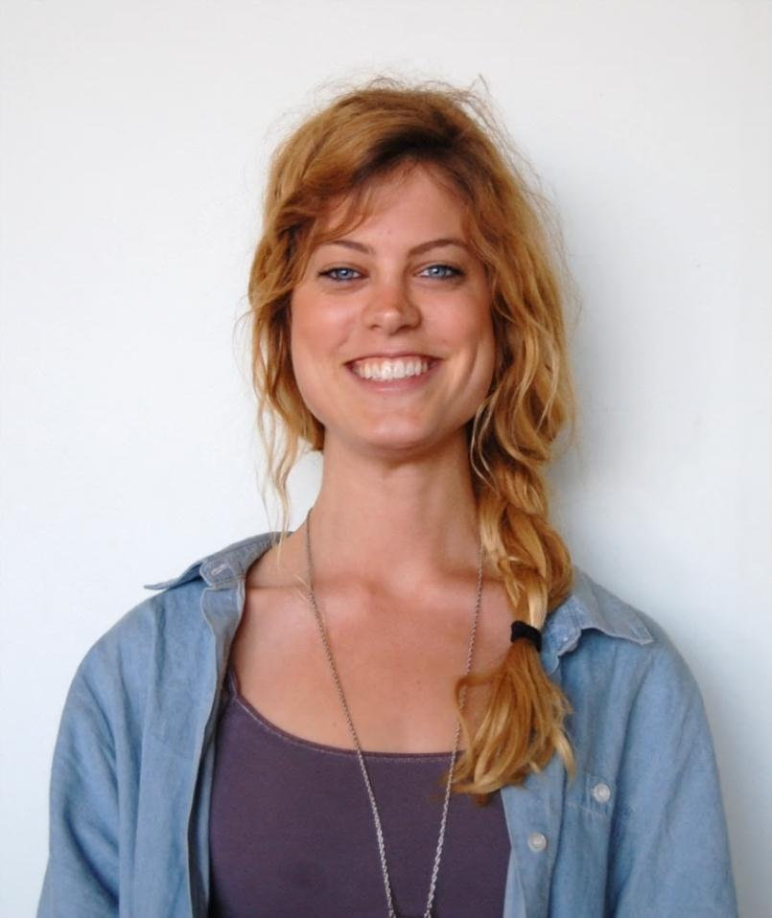
Kacie Scherler Recipient of Ministry Internship Grant from the Center for Faith and Learning and Religion Division
Kacie will be working as a youth ministry intern for the Conejo Valley Church of Christ in Thousand Oaks, California.

Slide 9
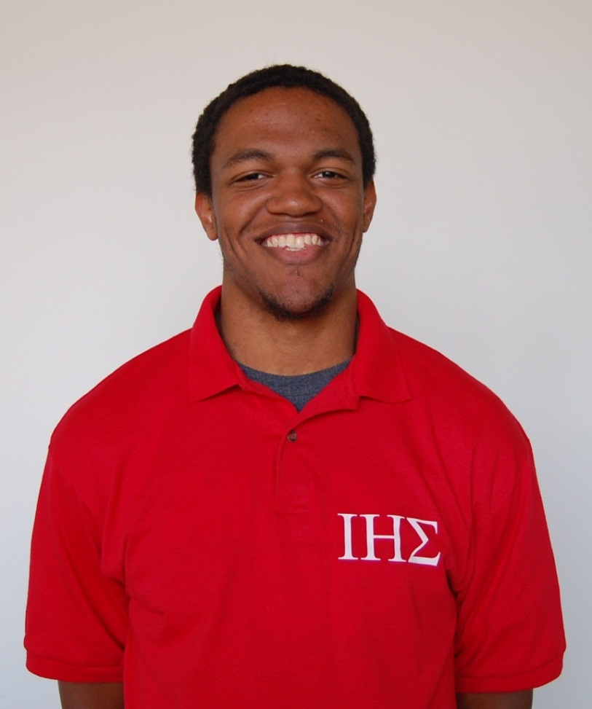
Nathaniel Tinner Recipient of Ministry Internship Grant from the Center for Faith and Learning and Religion Division
Nathaniel will be a ministry intern for the Malibu Gathering in Malibu, California, helping with the IT, AV, and worship ministries.

Slide 10
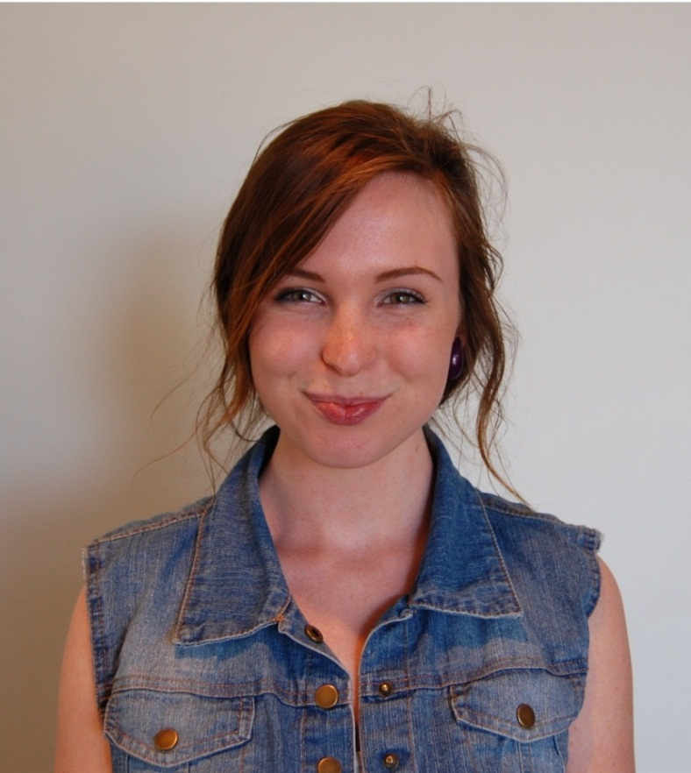
Sara Leonard Recipient of Ministry Internship Grant from the Center for Faith and Learning and Religion Division
Sara will be a youth ministry intern for the University Church of Christ in Malibu, California.

Slide 11
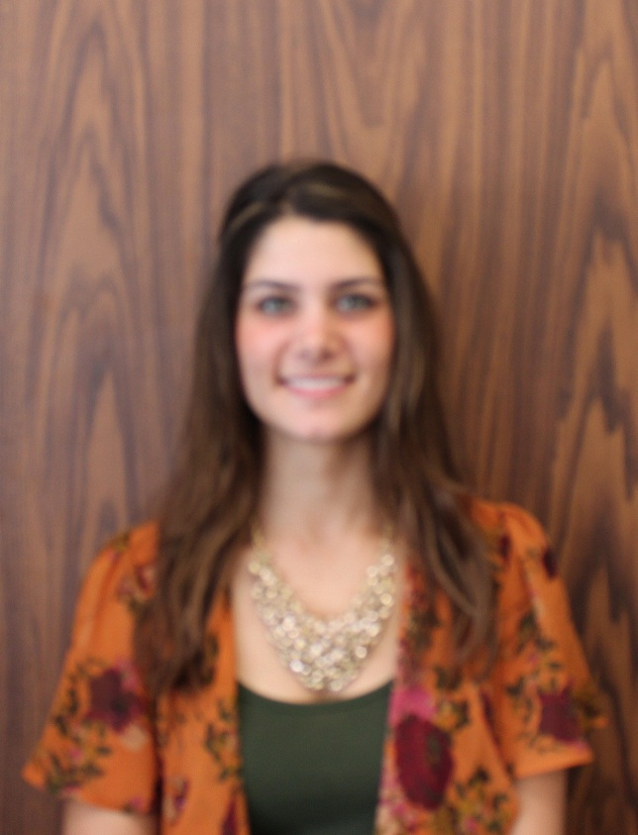
Shaina Kohli Recipient of Ministry Internship Grant from the Center for Faith and Learning and Religion Division
Shaina will be a youth ministry intern for the Hilltop Community Church of Christ in El Segundo, California.

